Slide 1

EXPLORATORY DATA ANALYSIS
VEHICLE INSURANCE
PROJECT BY
PARAS CHAUHAN

Slide 2

Vehicle insurance plays a vital role in contemporary life, offering financial security and peace of mind to both individuals and businesses. Grasping the factors that impact insurance claims is crucial for insurance companies to manage risk effectively and deliver the best coverage to their clients. In this exploratory data analysis (EDA) project, we examine a dataset with detailed vehicle insurance information, with the goal of uncovering valuable insights to guide decision-making within the insurance industry.
The dataset in question contains extensive information related to vehicle insurance, including details about insured individuals, their vehicles, and the corresponding insurance claims. It provides a detailed view of various factors such as age, gender, geographic location, insurance premiums, policy types, and more. By thoroughly analysing these variables, our goal is to identify patterns, trends, and correlations that reveal insights into the factors influencing insurance claims.

Slide 3

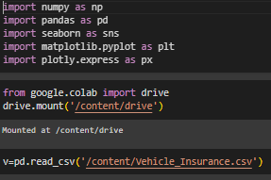

I have conducted my work using Google Colab Notebook.
The dataset has been imported from Google Drive.
As we begin our Exploratory Data Analysis (EDA), I've named the dataset v.
The dataset comprises of 381109 rows and 12 columns.
For data cleaning, I have utilized libraries Numpy , Pandas , Matplotlib , Plotly
and Seaborn .
Any duplicate entries that were found have also been removed.

Slide 4
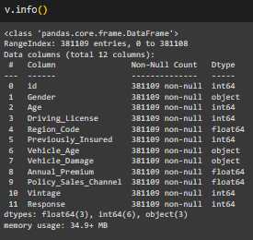
The dataset being analysed offers an extensive array of information about vehicle insurance, including various details about insured individuals, their vehicles, and the insurance claims associated with them. The following is a thorough overview of the dataset's main components and variables:
Age: The age of the insured person, which reflects their life stage and possible risk profile.
Gender: The gender of the insured person, which could impact insurance premiums and the frequency of claims.
Driving License: The status or type of driving license held by the insured individual, which may include factors such as the license's validity, class, and any endorsements or restrictions.

Slide 5
Region Code: The geographic location of the insured individual, reflecting regional differences in risk factors and claim rates.
Previously Insured: This refers to whether the insured individual had prior vehicle insurance coverage before their current policy. It can indicate their previous insurance history and may influence risk assessment and policy terms.
Vehicle Age: The age or model year of the insured vehicle, indicating its condition and the potential risk of accidents or damage.
Vehicle Damage: Details about the vehicle's damage status, which can influence insurance premiums and the frequency of claims.
Annual Premium: The total amount of money paid by the insured individual for
their vehicle insurance policy over the course of a year.

Slide 6

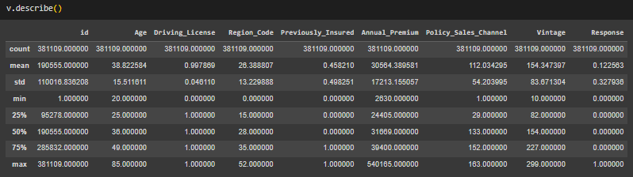
Policy Sales Channel: The method or platform through which the insurance policy was sold to the insured individual. This could include channels such as direct sales, brokers, online platforms, or agents.
Vintage: Typically refers to a vehicle that is at least 20 to 30 years old, depending on the definition used by different organizations or regions.
Response: In a general context, a response is an answer or reaction to a question, request, or stimulus.

Slide 7



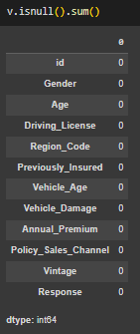
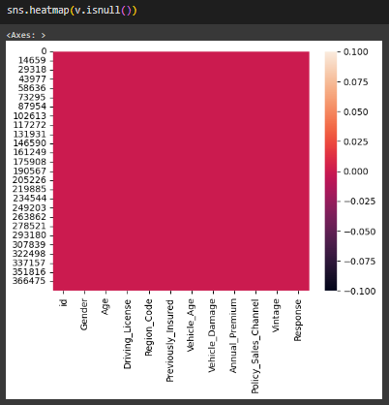
As we have seen that this data set has 0 null values. So we can move to the next step.

Slide 8
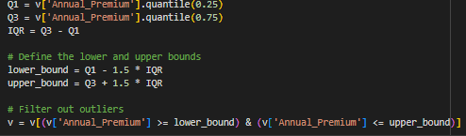
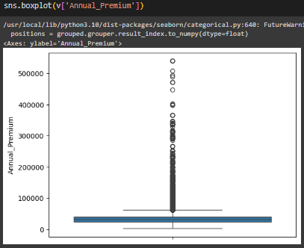
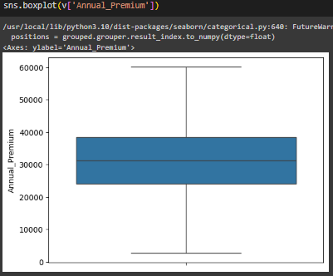
Key consideration : Although we have 0 null values, we still need to examine numerical features- 'Annual Premium’ for outliers to ensure data balance and improve the quality of insights .
Using IQR METHOD for removing these outliers.

Slide 9
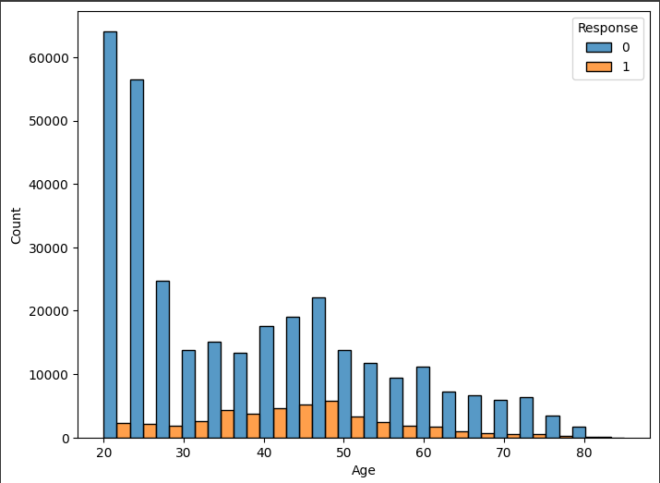

Slide 10

Age Distribution : The dataset has a wide age range, from around 20 to 80 years old. The majority of individuals fall within the 20-50 age group, with the peak around the 30-40 age range.
Response Variable : The graph shows two distinct categories for the "Response" variable (0 and 1). We can infer that this variable represents a binary outcome, such as whether a customer made a purchase or not.
Response by Age : The graph suggests that the response rate varies across different age groups. For instance, the response rate appears higher in the 30-50 age range compared to the younger and older age groups

Slide 11
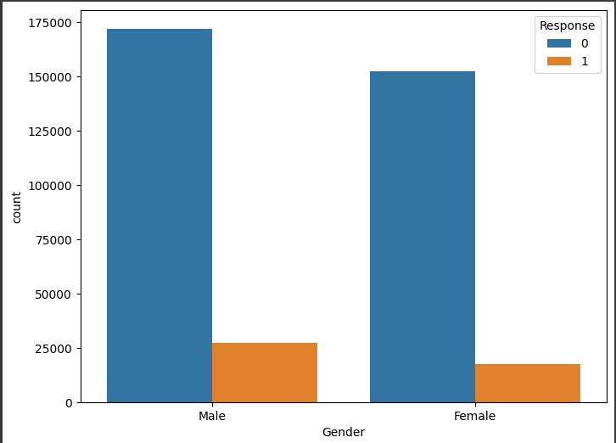

Slide 12
More males responded : The blue bars, representing response '0', are significantly higher for males than females, indicating that more males participated in the survey or provided this response.
Similar response patterns : The proportion of '1' responses (orange bars) to '0' responses seems consistent across both genders, suggesting that there might not be a significant difference in the way males and females responded to the question or survey.

Slide 13
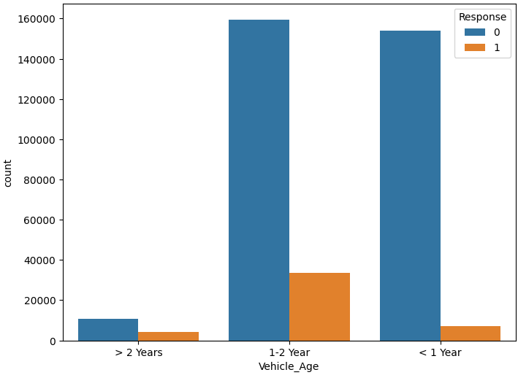

Slide 14

Most vehicles are less than 1 year old. This category has the highest count for
both response values.
Response 0 is more frequent overall. For each vehicle age group, the count for response 0 is higher than response 1.
Response 1 is relatively more common for vehicles older than 2 years. While response 0 still dominates, the proportion of response 1 is slightly higher in the oldest age group compared to the other two.

Slide 15
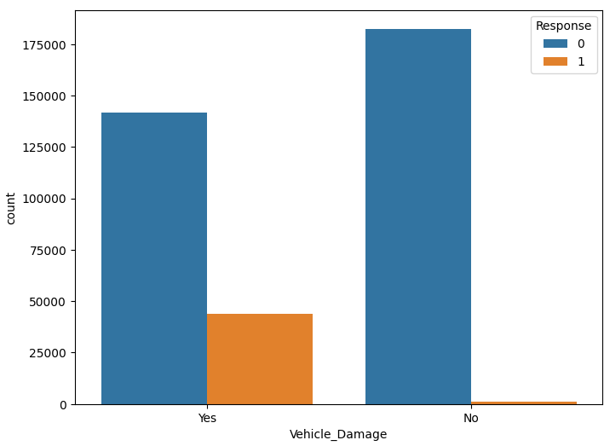

Slide 16
More loans are approved for those without vehicle damage.
The "No" category under "Vehicle Damage" has significantly higher counts for both approved (Response = 1) and rejected (Response = 0) loans.
Vehicle damage negatively impacts loan approval .
While many loans are still approved for those with vehicle damage, the proportion of approvals is lower compared to those without vehicle damage.
The majority of loan applicants do not have vehicle damage . This is evident from the much higher counts in the "No" category compared to the "Yes" category.

Slide 17
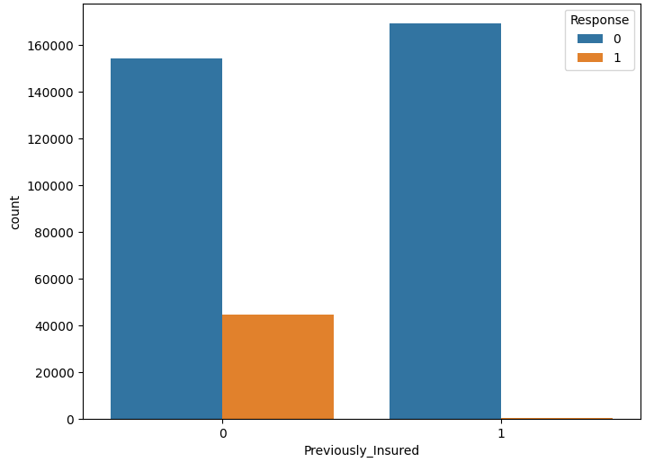

Slide 18
Class Imbalance : The dataset is imbalanced, with a significantly higher number of individuals who were previously insured (value 1) compared to those who were not (value 0).
Response Rate : The response rate is higher for individuals who were previously insured. This indicates that people who have had insurance in the past are more likely to respond positively to a new insurance offer.
Target Variable : "Response" is likely the target variable in this analysis, indicating whether an individual responded positively to an offer.
Predictive Power : "Previously Insured" could be a valuable predictor for the "Response" variable, given the difference in response rates

Slide 19
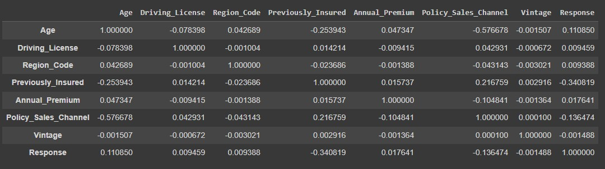

Slide 20
Positive Correlations :
Age : There is a moderate positive correlation with insurance claims. Response : Shows a moderate positive correlation with insurance claims. Insurance Claim : Has a strong positive correlation with the response.
Negative Correlations :
Previously Insured : Exhibits a strong negative correlation with insurance claims. Policy Sales Channel : Demonstrates a moderate negative correlation with both insurance claims and previously insured status.
Age : Displays a slight negative correlation with the Policy Sales Channel. Annual Premium : Shows minor negative correlations with both the Policy Sales Channel and insurance claims.

Slide 21
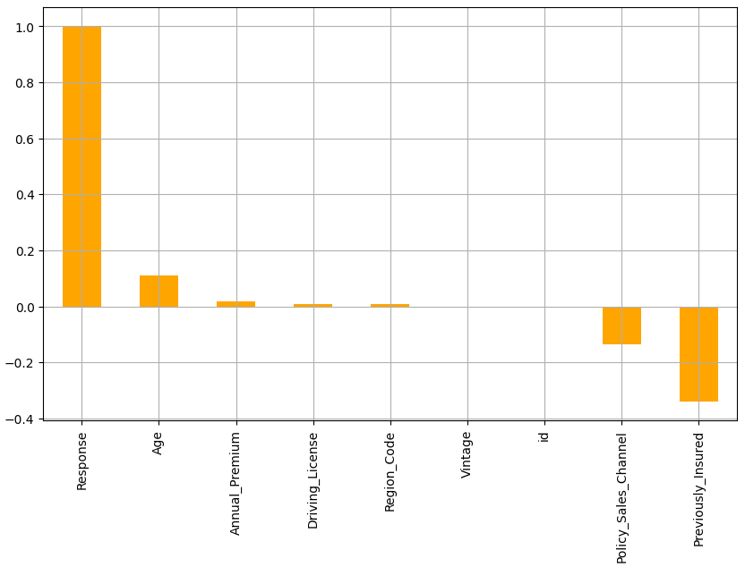


Slide 22

Strong Positive Correlation:
The "Response" variable has a strong positive correlation with the "Response" feature, which is expected as it's likely the same variable.
Moderate Positive Correlation:
The "Age" feature has a moderate positive correlation with the "Response" variable. This suggests that as age increases, the response variable tends to increase as well.
Weak Positive Correlation:
The "Annual_Premium" feature shows a weak positive correlation.
Very Weak or No Correlation:
The features "Driving_License," "Region_Code," "Vintage," and "id" show very weak or almost no correlation with the "Response" variable. This suggests these features do not significantly influence the target variable.
Moderate Negative Correlation:
The "Policy_Sales_Channel" and "Previously_Insured" features have a moderate negative correlation with the "Response" variable. This means as these features increase, the response variable tends to decrease

Slide 23
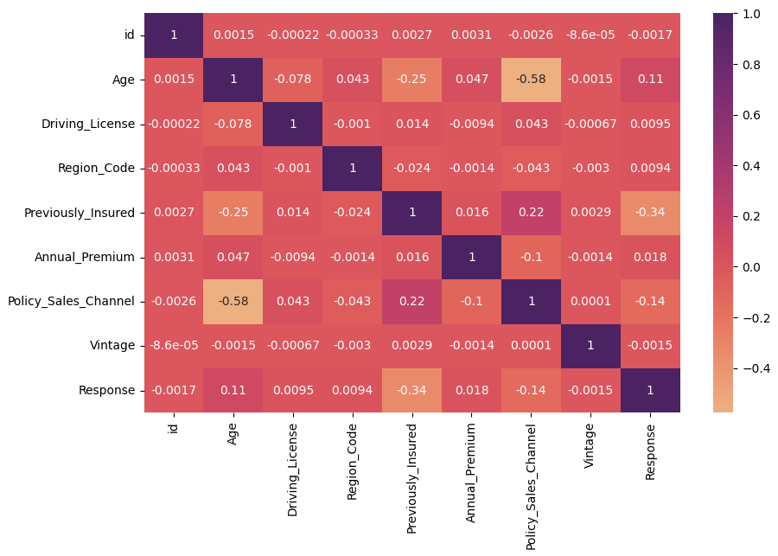

Slide 24
This correlation matrix provides a quick visual representation of the relationships between variables.
The strongest positive correlation observed is between Previously_Insured and Response, which could be a valuable insight for marketing strategies.
The lack of strong correlations suggests that the variables are relatively independent of each other.
For further analysis, it is recommended to delve into individual variable relationships using scatter plots or other visualization techniques.

Slide 25

EDA project provided valuable insights into the dynamics of vehicle insurance, highlighting the factors that influence insurance claims, premiums, and customer behavior. Key findings include.
Age, vehicle age, and region are significant predictors of insurance claims and premiums. Gender does not appear to be a significant factor in insurance claims.
Comprehensive policies are the most common type of insurance coverage among insured individuals. Customer loyalty and tenure with the insurance company are associated with lower claim frequencies. Based on these insights, the following recommendations are proposed for insurance companies.
Develop personalized insurance products and pricing strategies tailored to different age groups, vehicle types, and regional risk factors.

Slide 26

Enhance customer loyalty programs and retention strategies to incentivize
long-term relationships and reduce claim frequencies.
Monitor and analyze claim data regularly to identify emerging trends, patterns, and risk factors, enabling proactive risk management and strategic decision- making.
This dataset offers a rich and diverse set of variables that provide valuable insights into the dynamics of vehicle insurance. Through meticulous data pre processing, visualization, and statistical analysis, the project successfully identified key factors influencing insurance claims, premiums, and customer behaviour . The findings from this EDA project can inform strategic decision- making processes within the insurance domain, aiding in the development of personalized insurance products, pricing strategies, and customer retention initiatives tailored to different demographic groups, vehicle types, and regional risk factors.

Slide 27
THANK YOU FOR READING
FOR CODING PART :
https://github.com/ParasChauhan777/Vehicle-Insurance-

